Slide 1
Robust-and-evolvable
Resilient Software Systems
Open Problems and Lessons Learned
Vincenzo De Florio
www.pats.ua.ac.be
Notes:
1

Slide 2
Reflections & lessons learned...
...on how to build evolvable & robust resilient systems
Evolvable, robust, and resilient: definitions
Personal view on key requirements and dimensions
Experiences on how robustness evolve with evolvability requirements and dimensions
Conclusions and next steps

Slide 3
Definitions and questions - 2
Robustness: “Feature persistence under (un)foreseen perturbations, reached through parametric/structural re-organizations” [Jens]
  How to achieve – and prove – the emergence of robustness?
  Single “Gestalt”, several domain- (feature-) specific solutions...
Resilience: functional and non-functional identity persistence (e.g. dependability)

Slide 4
Robust evolvability: depends on several parameters
M: Sensitivity to change
  The wider the sensorial spectrum, the higher
  the chances of being aware of change
A: Ability to analyze, correlate past and
present sensorial data & Knowledge
P: Ability to plan reactions (e.g. firing
rules based on acquired Knowledge)
E: Action spectrum
  Defines feasible vs. infeasible reactions
Reaction latencies, complexity,
deterministic behaviour....

Slide 5
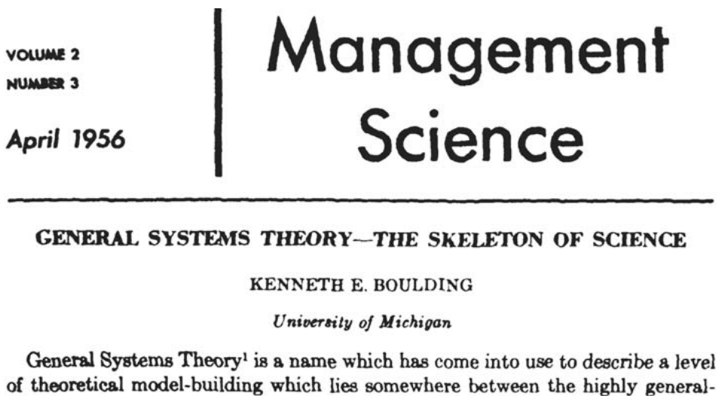
Boulding’s categories
Kenneth Boulding
developed a scale
ranking systems and
SoS according to M+A (lower levels) and P+E (higher levels)
  “Thermostats”, “Cells”, “Plants”, “Animals”, “Beings,”...

Slide 6
Key dimensions
In what follows, P+E = Evolution engine
Two dimensions appear particularly relevant here:
  Evolution engine complexity
  (Evolution engines multiplicity) +
  (complexity of their interactions)

Slide 7

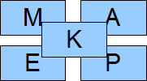
Complexity of
evolution engine
Phenotypically plastic:
simple parametric
adaptation

Slide 8
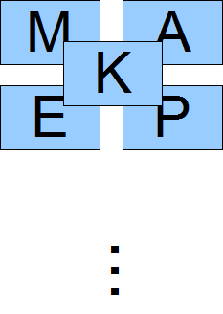
Complexity of
evolution engine
Phenotypically plastic,
switching between
predefined known
organizations

Slide 9
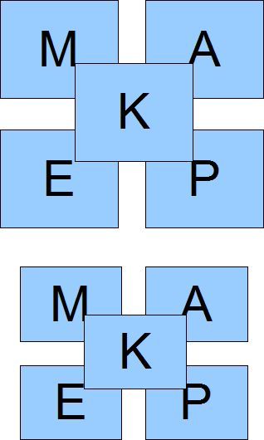
Phenotypically dynamic:
complex compositional
and parametric
adaptation

Slide 10
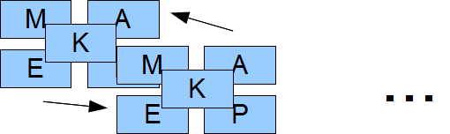
Simple forms of
interaction, few
entities

Slide 11
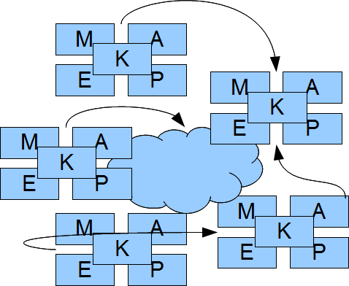
Ecosystems with
multiple complex
social organizations;
heterarchies

Slide 12
The higher the level,
the more difficult to assure
robustness and resilience

Slide 13
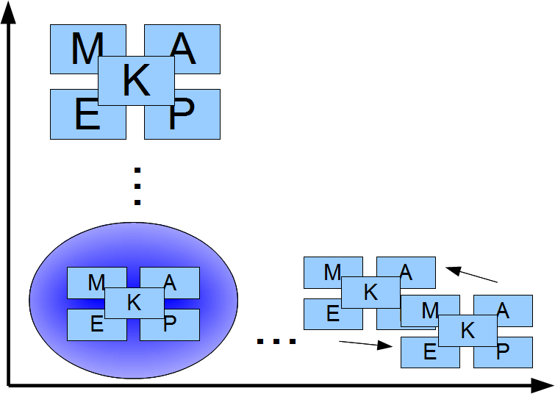
First example
Autonomically redundant data structures (RDS)
  Phenotypically static
    Single adaptation strategy based on one parameter (redundancy degree)

Slide 14
Redundancy = f(risk(t))
Dynamically redundant data structures
  Autonomic management of redundancy
  RDS where redundancy changes dynamically after risk of scheme failure
  risk(t): Indirect assessment

Slide 15
Indirect deduction of risk
R = 0
R = 1/3
R = 2/3
R =1

Slide 16
Intuitive formulation of risk-throughout-evolution
n(i) = redundancy at voting round i
= 2p(i)+1 (for some p(i)>0)
m(i) = card {replicas that agree after
voting round i }, 1 ≤ m(i) ≤ n(i)
Then risk(i) =
(n(i) – m(i))/p(i) when m(i) > p(i)
1 otherwise
Linear (naïve)
formulation

Slide 17
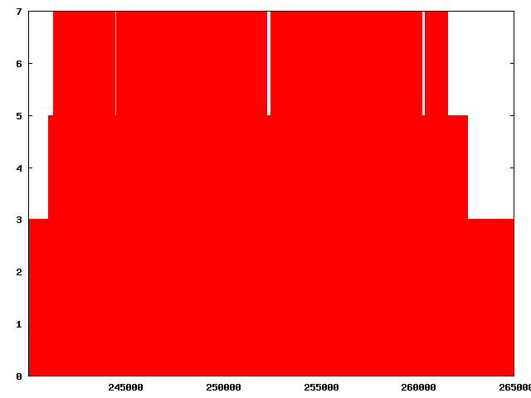
Evolution throughout fault injection
Redundancy
t

Slide 18
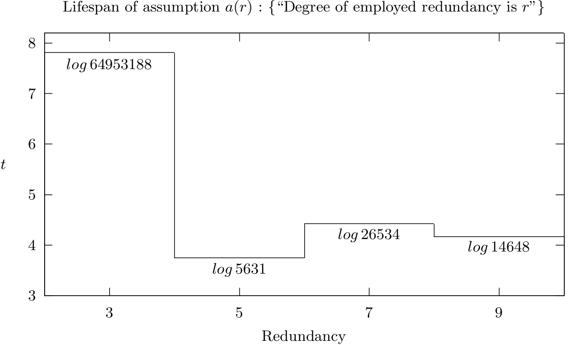
ESEC/FSE Workshop on
Assurances for Self-Adaptive Systems

Slide 19
First example – conclusions
Simple and stable evolution engine → robust
  Reduced complexity
  Convenient formulation of robustness assertions
  Predictable behaviours

Slide 20
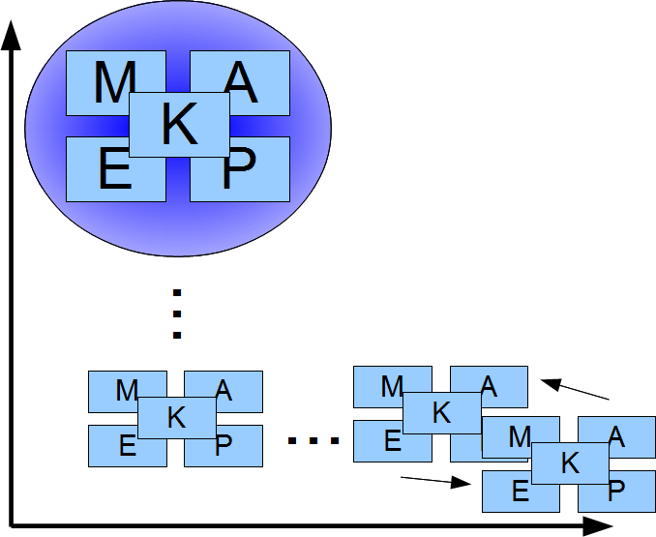
Second example
Transformer middleware
  Phenotypically dynamic
  Multiple domain-specific “planners” are selected and merged on the fly
  Component-based application reshaped accordingly

Slide 21
Second example – conclusions
Big problem: robustness
Will the emerging properties include the design goals?
No assurance (yet)
  Collaboration initiated (assisted model evolution)
For the time being, known-and-”safe” evolution states can be recognized

Slide 22
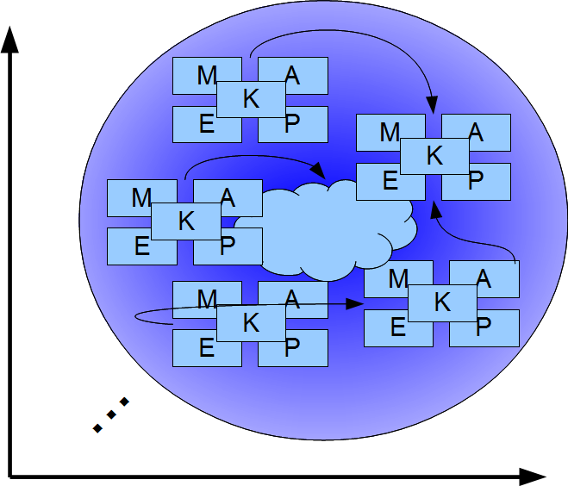
Third example –
Service-oriented communities
SoA
Orchestration of
devices and human beings
  different capabilities, backgrounds…
Responses to societal problems
(e.g. AAL)

Slide 23
SoC: General structure
Individual &
social concerns
optimization
Reasoning & coordination
Service registry
(e.g. via
Transformer)
Capabilities
Policies
Availability
Location…
Publish
Service
description
Publish
Events
People
Member
Bind
Member
Devices

Slide 24
SoC: Specialization:
Mutual Assistance Community
  Reducing social isolation of elderly people
  Promoting active life
  Reducing costs – best utilizing the social resources

Slide 25


Emergence of new services
Request stored in service center
Required service: Chatting with someone.
Location: Somewhere, Antwerp.
Deadline: 7pm, Sept. 4, 2011
Service model: Participant, or informal carer.
Required service: Walking with someone.
Location: Middelheim park, Antwerp.
Deadline: 8pm, Sept. 4, 2011.
Service model: Participant.
Service Matching
Join Mary?
NA
Request
Request
Join Kate?
Interactive TV
Join Kate?
Walk in park
NA
Yes
Request
Kate
Bind, take activity together
Yes
Mary

Slide 26
Conclusions
Target environment and target objectives: key factors in choosing the “best” system structure for evolvability
  Stable environment + simple tasks do not necessarily call for the utmost complexity…
  High forms of evolvability → high complexity
  → less guarantees
Bio-inspired MAS may provide an answer
  Spontaneous emergence of resilience
  Evolvable social organizations

Slide 27

More questions and some answers: www.igi-global.com/ijaras

Slide 28
Time for Questions…
vincenzo.deflorio@ua.ac.be

