Slide 1
Component-based Timed Hazard Analysis of Self-healing Systems
Workshop on Assurances for Self-Adaptive Systems
Szeged, Hungary, September 4, 2011
Claudia Priesterjahn and Dominik Steenken
University of Paderborn
Matthias Tichy
University of Augsburg

Slide 2
Motivation
Mechatronic systems
Mechanical, electrical, control, software engineering
Safety-critical
Guarantee correctness
Random errors
Due to wear of physical system parts
Cause hazards: Situation with a potential accident
Hazard analysis
Use self-healing to reduce hazards
Problem:
Propagation of errors during self-healing needs to be analyzed
Hazard: wrong speed
Component-based Timed Hazard Analysis of Self-healing Systems - Claudia Priesterjahn
September 5, 2011
2

Slide 3
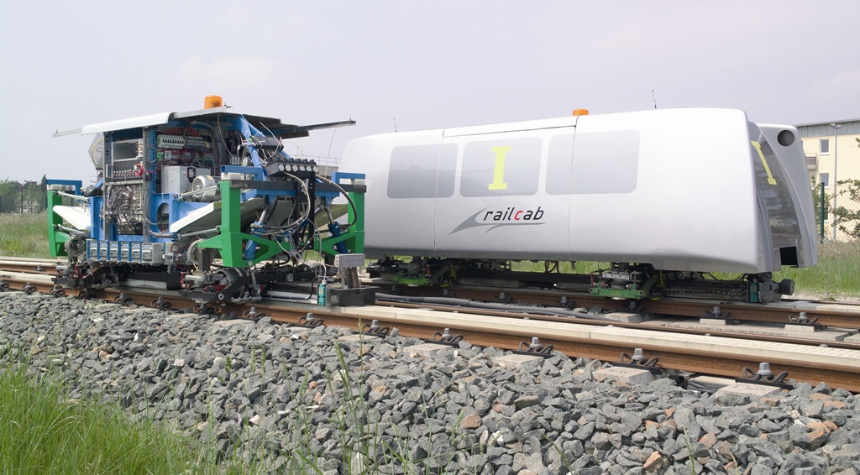
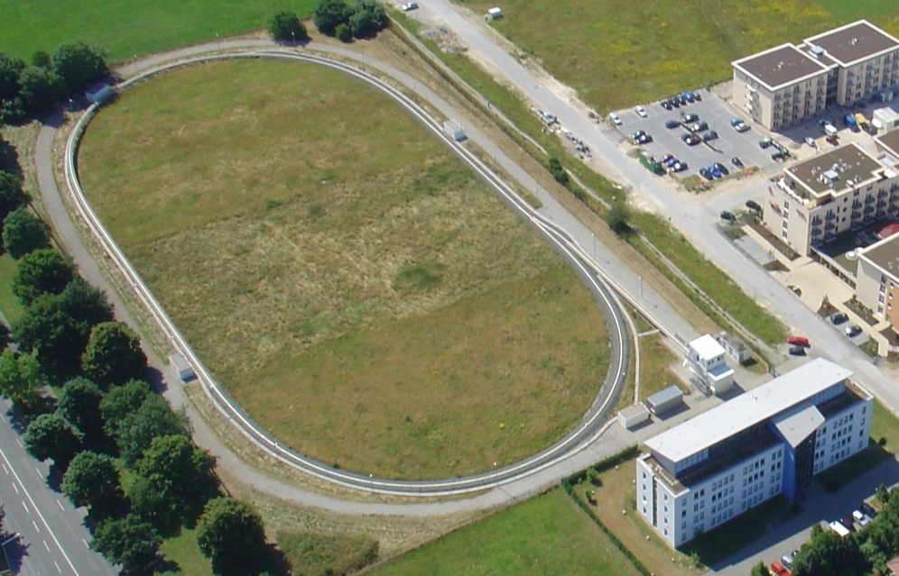
Application Example
RailCab-system
Rail vehicles
Real-world prototypes
No driver – steered by software
Test Vehicles
Test Track

Slide 4
Architecture Model

Slide 5
Failure Propagation
f_speedctrl
≥1
f
f
f
f
f
f
≥1
f
f
f
wrong speed
f
f
f
f
f
f
&
f
e
e
f
f
f
e
error
e
e
f
failure
Hazard specification: wrong speed⇔ f_speedctrl

Slide 6
Failure Propagation and Reconfiguration
≥1
f
f
f
f
f
f
≥1
f
f
f
wrong speed
no hazard
f
f
f
f
f
f
&
f
e
e
f
f
f
e
e
Hazard analysis needs to take into account:
Modification of the failure propagation introduced by the reconfiguration
Propagation times

Slide 7
Failure Propagation Time
Enhance failure propagation graph with time intervals
Timed Failure Propagation Graph
Goal:
Which error or failure is active at which point in time?
Define formal semantics
Time Petri Net^{[CR05]}
Marked Petri Net
Transitions extended by firing times
Reachability analysis
[CR05] F. Cassez and O.-H. Roux: „Structural translation from time petri nets to timed automata“ ENTCS 2005.

Slide 8
Mapping from Timed Failure Propagation Graph to Time Petri Net
Timed Failure Propagation Graph
Time Petri Net
2

Slide 9
Failure Propagation in TFPG and Time Petri Net

Slide 10
1. Determine Minimal Cut Sets
Which cut sets need to be analyzed?
Cut sets:
{e₁}
{e₂}
{e₃,e₄}

Slide 11
2. Partition the Timed Failure Propagation Graph
Reachability analysis only for the part of the system that is affected by the reconfiguration
Identify the subgraph that is affected by the reconfiguration
Component-based Timed Hazard Analysis of Self-healing Systems - Claudia Priesterjahn
September 5, 2011
11

Slide 12
Reconfiguration
Durative Reconfiguration Rule

Slide 13
2. Partition the Timed Failure Propagation Graph
Reachability analysis only for the part of the system that is affected by the reconfiguration
Identify the subgraph that is affected by the reconfiguration:
All paths that lead from an error to the last node that is altered by the reconfiguration
Component-based Timed Hazard Analysis of Self-healing Systems - Claudia Priesterjahn
September 5, 2011
13

Slide 14
3. Analyze the Affected Subgraph
Result:
Active errors and failures after the reconfiguration
Determine which errors and failures might be active during the execution of the reconfiguration
Active failures: f₅, f₆
Apply reconfiguration rule
Duration: [30,42]

Slide 15
4. Analyze the System after the Reconfiguration
Can the active errors and failures still cause the hazard?
Information needed:
TFPG after reconfiguration
All errors and failures that may be activated after reconfiguration
f₅, f₆, f₇
Analysis:
Cut sets of remaining TFPG with hazardous top-event
{f₈}, {e₃, e₄}
Result:
{f₈} ⊈ {f₅, f₆, f₇}
{e₃, e₄} ⊈ {f₅, f₆, f₇}
Hazard prevented

Slide 16
Analysis (Summary)
Determine the minimal cut sets that lead to the hazard.
Extract a subgraph of the configuration's TFPG that is affected by the reconfiguration.
Analyze the subgraph of the configuration's TFPG that is affected by the reconfiguration.
Analyze, if the reconfiguration was successful in reducing the hazard.

Slide 17
Conclusion
Timed hazard analysis:
Propagation of failures over time
Including failure propagation during reconfiguration
Future work:
Automatic generation of timed failure propgation graphs
Delay between trigger and execution of reconfiguration
Add probability distribution over time to propagation time intervals
Analysis during run-time

